Slide 1
Computer Vision
Part 2: Edge Detection
ADF – Start 09:40

Slide 2

Agenda
Part 1: Filtering and Convolution
Part 2: Edge Detection
Edge and Derivative
Prewitt, Sobel, Marr-Hildreth, and Canny Edge Detector
Computer Vision

Slide 3
Edges
Computer Vision

Slide 4
Edges
Discontinuities in images
Edges occur where the contrast changes in the scene,
and hence represent shape and structure information contained in the scene.
Computer Vision

Slide 5
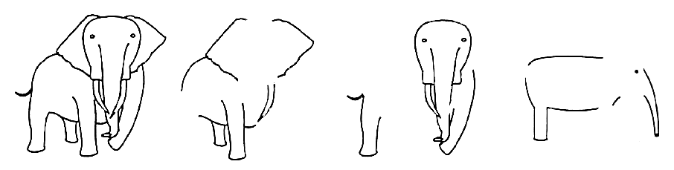
Edges
Features that are often useful for initializing an image analysis procedure.
Important information for understanding an image
By moving “non-edge” data we also simplify the data.
Computer Vision

Slide 6
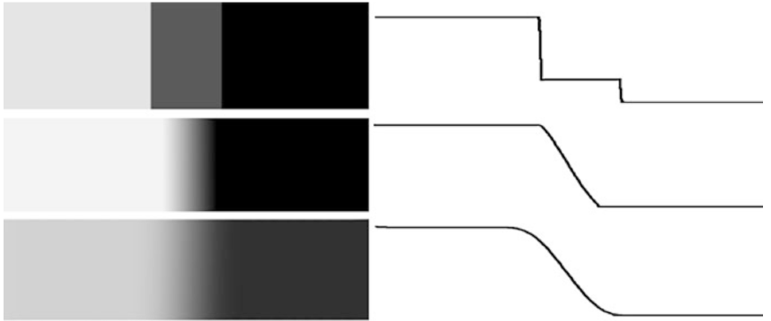
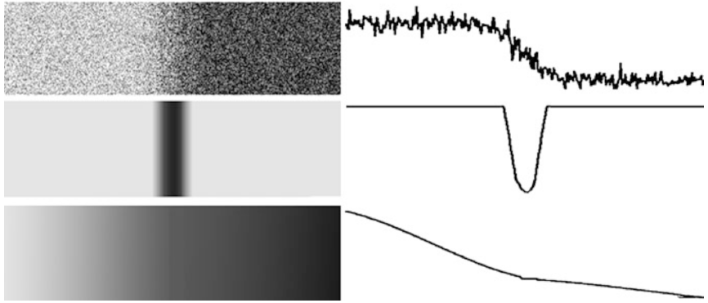
Edge Models
An edge is a place of rapid change in the image intensity function
Computer Vision

Slide 7
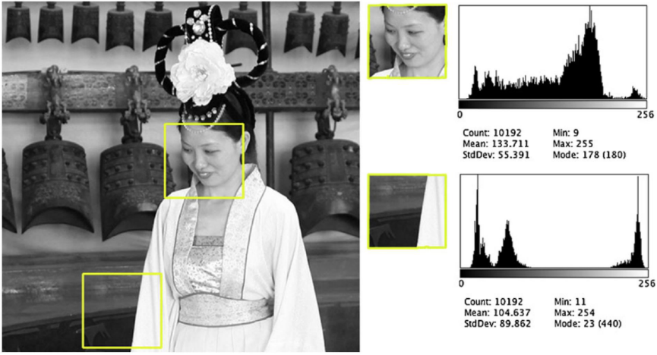
Image Histogram
Computer Vision

Slide 8
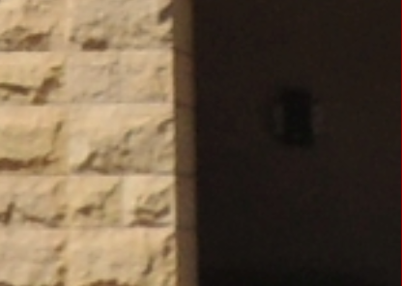
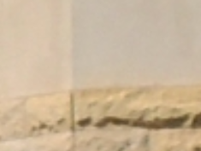
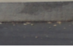

Origins of Edges
Depth discontinuity
Surface color discontinuity
Surface normal discontinuity
Illumination discontinuity
Computer Vision

Slide 9
Edge Detection Technique
Computer Vision

Slide 10
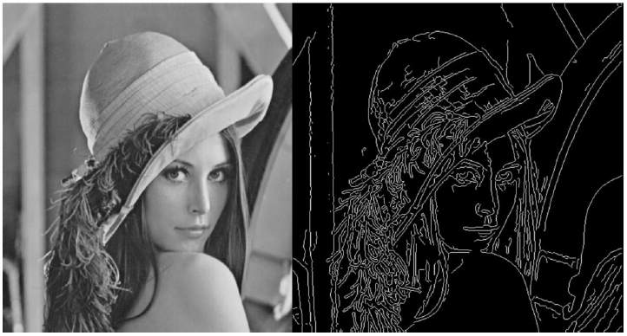
Edges Detection
Identify sudden changes (discontinuity) in an image
Most semantic and shape information can be encoded in edges
Marks the border of an object
More compact than pixels
Computer Vision

Slide 11
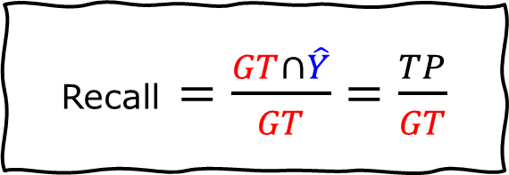
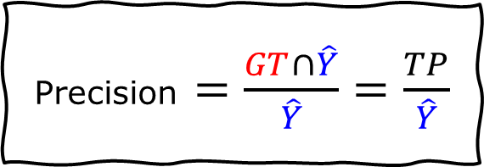
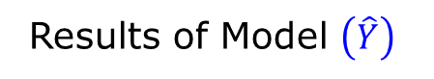

Edge Detection Evaluation
Precision $=\frac{GT∩\hat{Y}}{\hat{Y}}=\frac{TP}{\hat{Y}}$
Ground Truth $\left(GT\right)$
False Positives (FP)
True Negative (TN)
Recall $=\frac{GT∩\hat{Y}}{GT}=\frac{TP}{GT}$
True Positives (TP)
False Negative (FN)
Results of Model $\left(\hat{Y}\right)$
Computer Vision

Slide 12
Edge Detection Evaluation
Good detection:
find all real edges,
ignoring noise or other artifacts
Good localization:
as close as possible to the true edges
one point only for each true edge point
Computer Vision

Slide 13
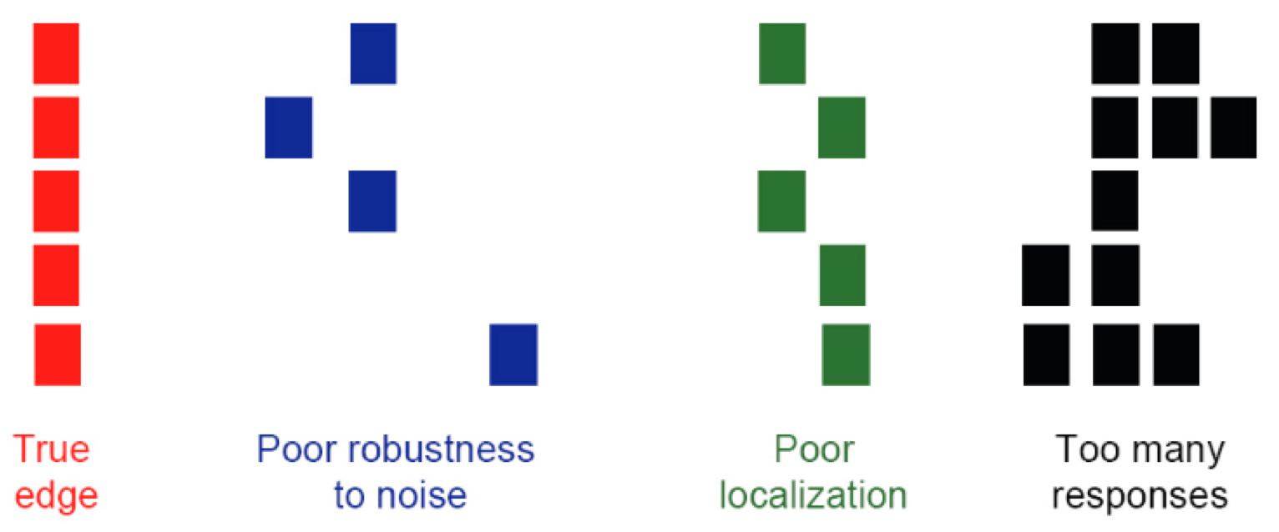
Edge Detection Evaluation
Computer Vision

Slide 14
45 Years History of Edge Detection
[Pre-Deep Learning]
Computer Vision

Slide 15
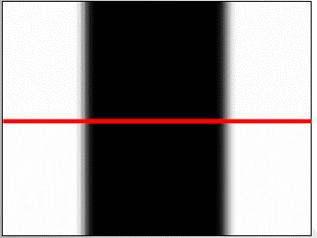
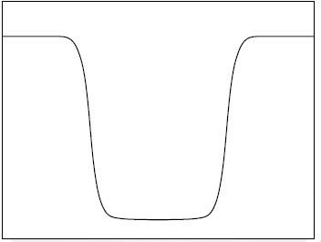
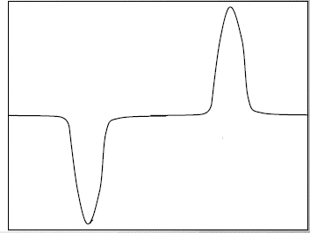
Edge Models
An edge is a place of rapid change in the image intensity function
intensity function
(along horizontal scanline)
image
first derivative
edges correspond to
extrema of derivative
Computer Vision

Slide 16
Derivative
Computer Vision

Slide 17
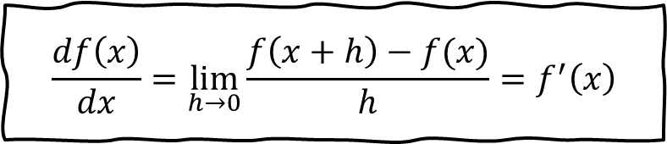
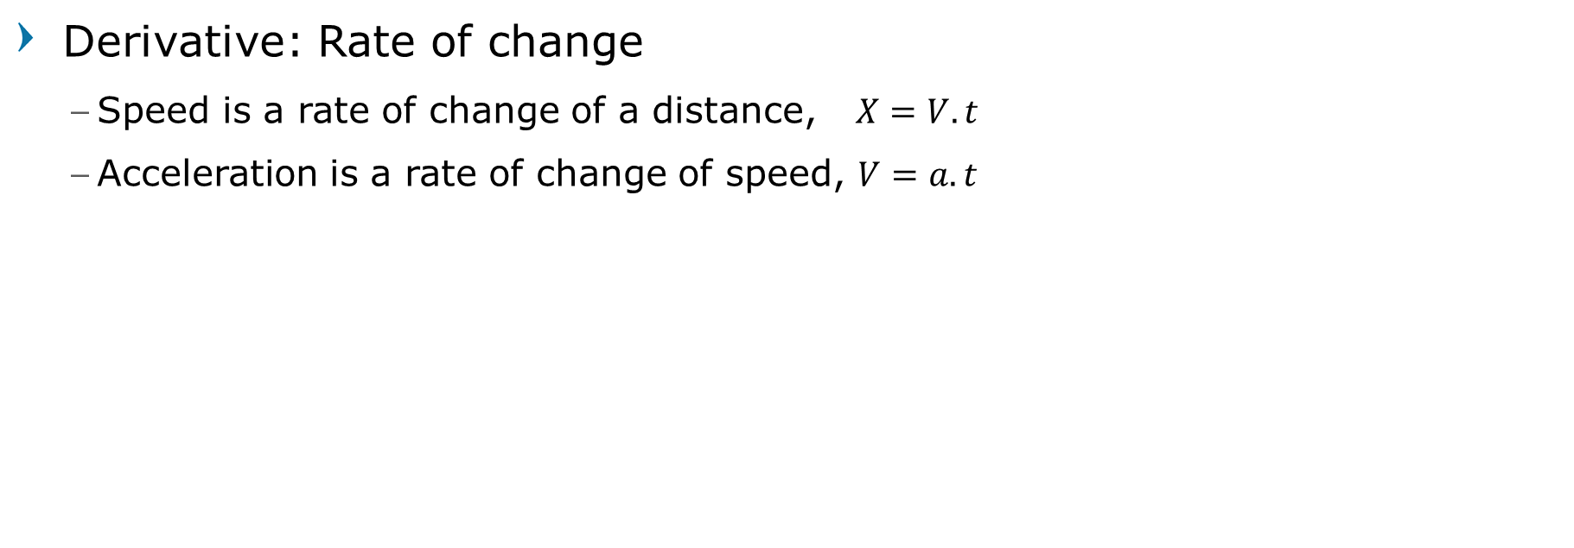
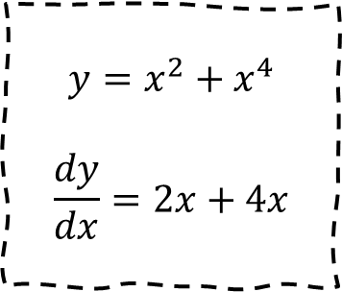
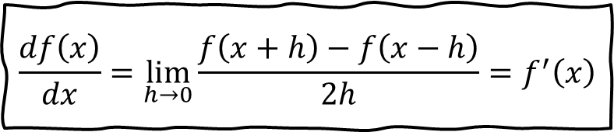
Derivatives
$$y=x^{2}+x^{4}$$
$$\frac{dy}{dx}=2x+4x$$
Derivative: Rate of change
Speed is a rate of change of a distance, $X=V.t$
Acceleration is a rate of change of speed, $V=a.t$
$$\frac{df\left(x\right)}{dx}=\lim_{h→0}{\frac{f\left(x+h\right)−f(x)}{h}}=f^{′}\left(x\right)$$
$$\frac{df\left(x\right)}{dx}=\lim_{h→0}{\frac{f\left(x+h\right)−f\left(x−h\right)}{2h}}=f^{′}\left(x\right)$$
Computer Vision

Slide 18
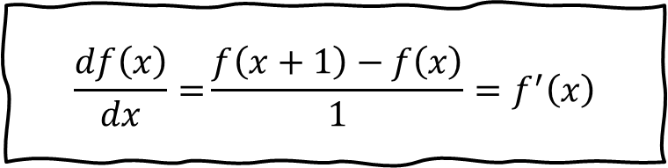
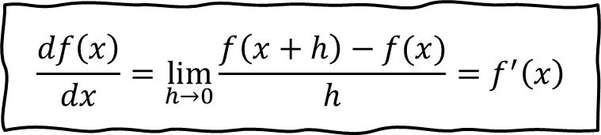
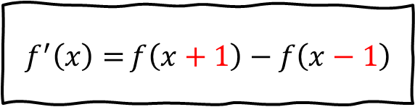
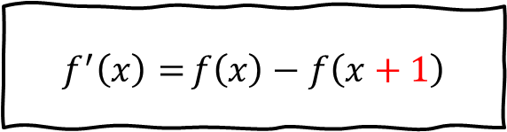
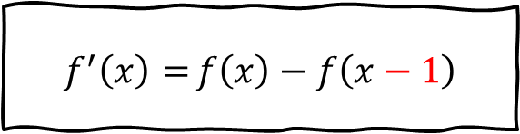
Discrete Derivatives / Finite Difference
Images are discrete
$$\frac{df\left(x\right)}{dx}=\lim_{h→0}{\frac{f\left(x+h\right)−f(x)}{h}}=f^{′}\left(x\right)$$
$$f^{′}\left(x\right)={f\left(x\right)−f\left(x−1\right)}$$
Backward difference
$$\frac{df\left(x\right)}{dx}={\frac{f\left(x+1\right)−f\left(x\right)}{1}}=f^{′}\left(x\right)$$
$$f^{′}\left(x\right)={f\left(x\right)−f\left(x+1\right)}$$
Forward difference
$$f^{′}\left(x\right)={f\left(x+1\right)−f\left(x−1\right)}$$
Central difference
Computer Vision

Slide 19
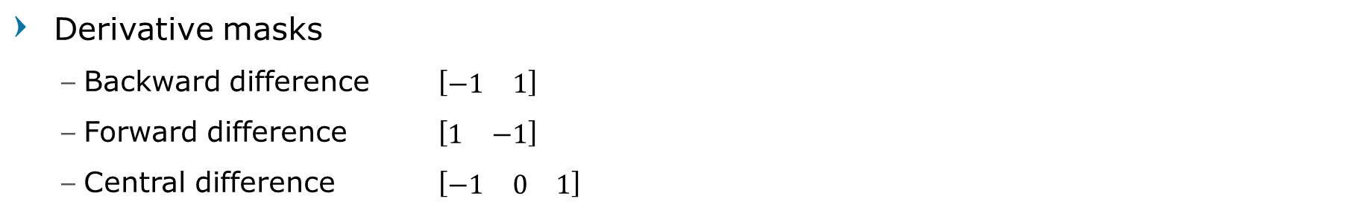
Finite Difference: 1D Example
$$f\left(x\right)$$ | 10 | 15 | 10 | 10 | 25 | 20 | 20 | 20
$$f^{′}\left(x\right)$$ | 0 | -10+15 | -15+10 | -10+10 | -10+25 | -25+20 | -20+20 | -20+20
 | 0 | 5 | -5 | 0 | 15 | -5 | 0 | 0
$$f^{′′}\left(x\right)$$ | 0 | -0+5 | -5+(-5) | -(-5)+0 | -0+15 | -15+(-5) | -(-5)+0 | -0+0
 | 0 | 5 | -10 | 5 | 15 | -20 | 5 | 0
Derivative masks
Backward difference $\left[\begin{matrix}−1 & 1\end{matrix}\right]$
Forward difference $\left[\begin{matrix}1 & −1\end{matrix}\right]$
Central difference $\left[\begin{matrix}−1 & 0 & 1\end{matrix}\right]$
Computer Vision

Slide 20
Derivative in 2D
Given function
Gradient vector
$$∇f\left(x,y\right)=\left[f_{x}, 0\right]$$
$$f\left(x,y\right)$$
$$∇f\left(x,y\right)=\left[0, f_{y}\right]$$
$$∇f\left(x,y\right)=\left[\frac{∂f\left(x,y\right)}{∂x},\frac{∂f\left(x,y\right)}{∂y}\right]$$
$$=\left[f_{x}, f_{y}\right]$$
$$θ$$
$$∇f\left(x,y\right)=\left[f_{x}, f_{y}\right]$$
Computer Vision

Slide 21
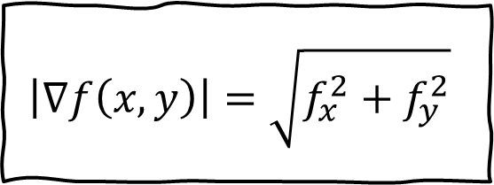
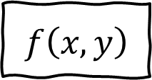
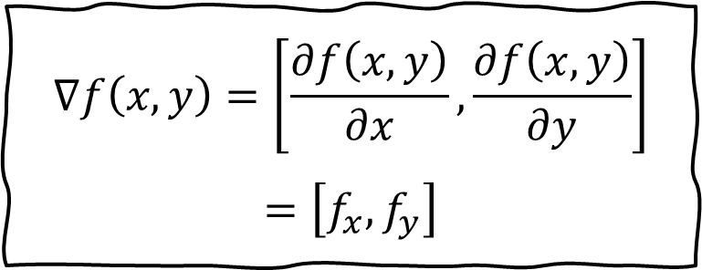
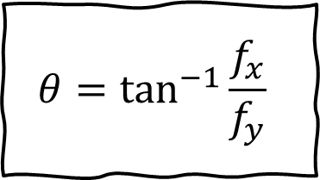
Derivative in 2D
Given function
Gradient vector
Gradient magnitude
Gradient direction
$$f\left(x,y\right)$$
$$\left|∇f\left(x,y\right)\right|=\sqrt{f_{x}^{2}+f_{y}^{2}}$$
$$∇f\left(x,y\right)=\left[\frac{∂f\left(x,y\right)}{∂x},\frac{∂f\left(x,y\right)}{∂y}\right]$$
$$=\left[f_{x}, f_{y}\right]$$
$$θ=\tan^{−1}{\frac{f_{x}}{f_{y}}}$$
Computer Vision

Slide 22
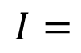
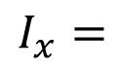
Derivative of Images Example
-1 | 0 | 1
10 | 10 | 20 | 20 | 20
10 | 10 | 20 | 20 | 20
10 | 10 | 20 | 20 | 20
10 | 10 | 20 | 20 | 20
10 | 10 | 20 | 20 | 20
0 | 10 | 10 | 0 | 0
0 | 10 | 10 | 0 | 0
0 | 10 | 10 | 0 | 0
0 | 10 | 10 | 0 | 0
0 | 10 | 10 | 0 | 0
$$I=$$
$$I_{x}=$$
Computer Vision

Slide 23
Derivative of Images Example
1
0
-1
10 | 10 | 20 | 20 | 20
10 | 10 | 20 | 20 | 20
10 | 10 | 20 | 20 | 20
10 | 10 | 20 | 20 | 20
10 | 10 | 20 | 20 | 20
0 | 0 | 0 | 0 | 0
0 | 0 | 0 | 0 | 0
0 | 0 | 0 | 0 | 0
0 | 0 | 0 | 0 | 0
0 | 0 | 0 | 0 | 0
$$I=$$
$$I_{x}=$$
Computer Vision

Slide 24
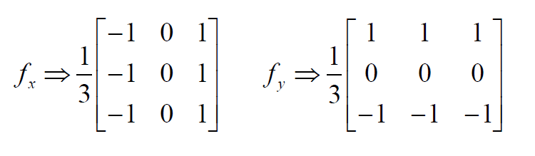
Derivative of Images
Derivative masks
Computer Vision

Slide 25
Derivative of Images Example
10 | 10 | 20 | 20 | 20
10 | 10 | 20 | 20 | 20
10 | 10 | 20 | 20 | 20
10 | 10 | 20 | 20 | 20
10 | 10 | 20 | 20 | 20
0 | 0 | 0 | 0 | 0
0 | 10 | 10 | 0 | 0
0 | 10 | 10 | 0 | 0
0 | 10 | 10 | 0 | 0
0 | 0 | 0 | 0 | 0
$$I=$$
$$I_{x}=$$
Computer Vision

Slide 26
Derivative of Images Example
10 | 10 | 20 | 20 | 20
10 | 10 | 20 | 20 | 20
10 | 10 | 20 | 20 | 20
10 | 10 | 20 | 20 | 20
10 | 10 | 20 | 20 | 20
0 | 0 | 0 | 0 | 0
0 | 0 | 0 | 0 | 0
0 | 0 | 0 | 0 | 0
0 | 0 | 0 | 0 | 0
0 | 0 | 0 | 0 | 0
$$I=$$
$$I_{x}=$$
Computer Vision

Slide 27
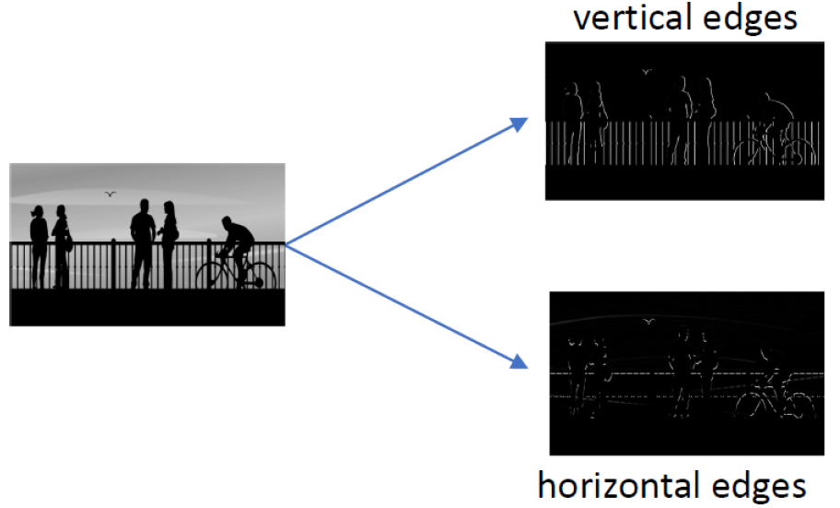
Edges in Image
Computer Vision

Slide 28
Edges in Image
Original Image
Gradient magnitude
x-direction
y-direction
Computer Vision

Slide 29
Image Noise
Computer Vision

Slide 30
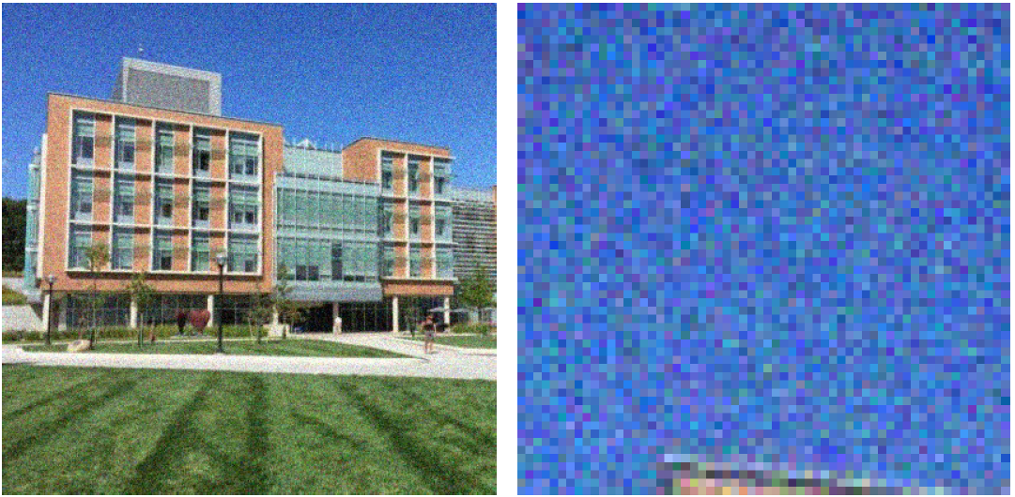
Image Noise
Computer Vision

Slide 31
Intensity profile
Computer Vision

Slide 32
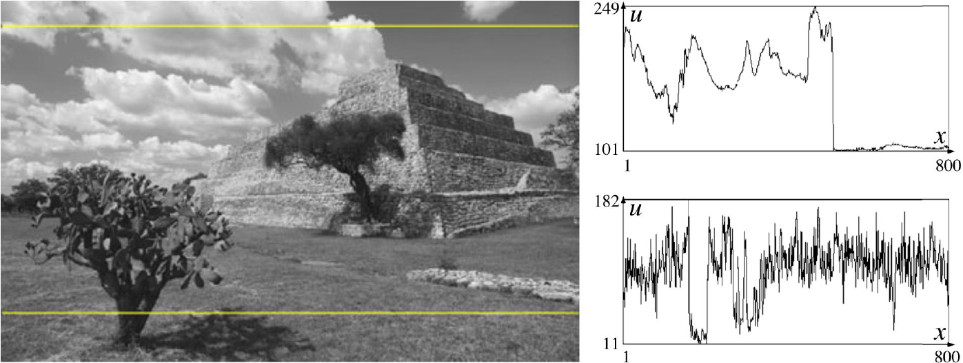
Image Histogram
Computer Vision

Slide 33
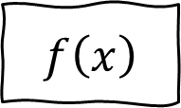
Effects of Noise
Consider a single row or column of the image
Plotting intensity as a function of position gives a signal
$$f\left(x\right)$$
Computer Vision

Slide 34
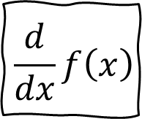
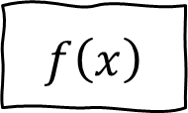
Effects of Noise
If the signal has noises, The derivative won’t be clear
$$f\left(x\right)$$
$$\frac{d}{dx}f\left(x\right)$$
Computer Vision

Slide 35
Effects of Noise
Sensitive to “tiny” edges
Computer Vision

Slide 36
Effects of Noise
Difference filters respond strongly to noise
Image noise results in pixels that look very different from their neighbors
Generally, the larger the noise the stronger the response
What can we do about it?
Computer Vision

Slide 37
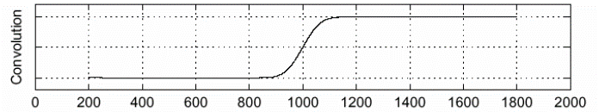


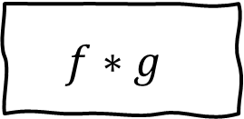
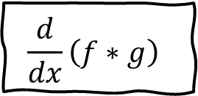
Solution: Smoothing
$$f$$
$$g$$
$$f∗g$$
$$\frac{d}{dx}\left(f∗g\right)$$
Computer Vision

Slide 38
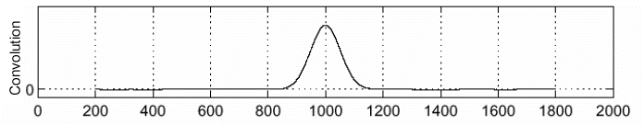
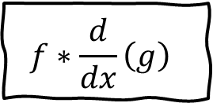
Solution: Smoothing
Convolution is differentiable
Saves us one operation
$$f∗\frac{d}{dx}\left(g\right)$$
Computer Vision

Slide 39
Smoothing Problem
Smoothing removes noise, but blurs edge.
Smoothed (1x1)
Smoothed (3x3)
Smoothed (7x7)
Computer Vision

Slide 40
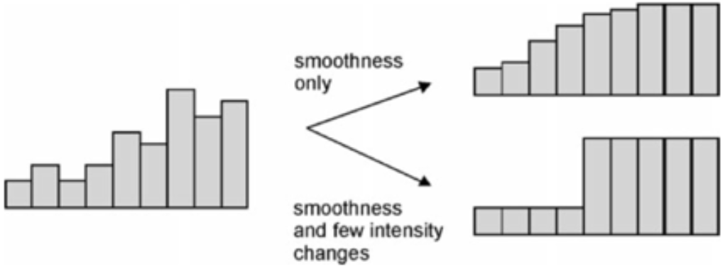
Unsharp Masking
Lower Noise, Higher Contrast
Not only noise removal, but edge enhancement is necessary
Edges are located in high frequency of the images
Computer Vision

Slide 41
Prewitt and Sobel Edge Detector
Computer Vision

Slide 42
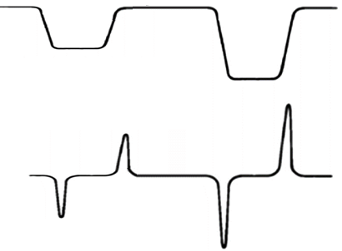
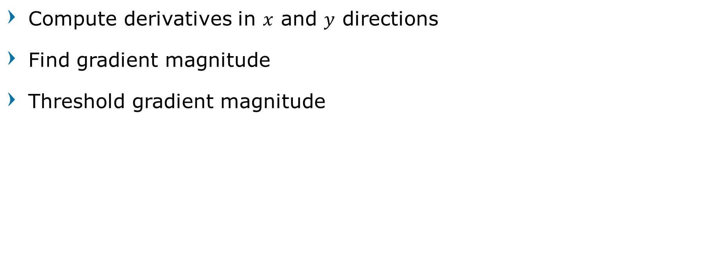
Prewitt and Sobel Edge Detector
Compute derivatives in $x$ and $y$ directions
Find gradient magnitude
Threshold gradient magnitude
threshold
Computer Vision

Slide 43
Prewitt and Sobel Edge Detection
Original image
Laplacian operator
Horizontal derivative
Vertical derivative
Computer Vision

Slide 44
Prewitt Edge Detector [1970]
average
smoothing in x
blurred
derivative filtering in x
edges in x
1
1
1
1 | 0 | -1
1 | 0 | -1
1 | 0 | -1
1 | 0 | -1
image
1
0
-1
1 | 1 | 1
0 | 0 | 0
-1 | -1 | -1
1 | 1 | 1
blurred
edges in y
average
smoothing in y
derivative filtering in y
Computer Vision

Slide 45
Prewitt Edge Detector [1970]
average
smoothing in x
blurred
derivative filtering in x
edges in x
1 | 1
1 | 1
1 | 1
1 | 0 | -1
1 | 0 | -1
1 | 0 | -1
1 | -1
image
1 | 1 | 1
0 | 0 | 0
-1 | -1 | -1
1 | 1 | 1
1 | 1 | 1
1
-1
blurred
edges in y
average
smoothing in y
derivative filtering in y
Computer Vision

Slide 46


Vertical Edge Detection
20 | 20 | 20 | 0 | 0 | 0
20 | 20 | 20 | 0 | 0 | 0
20 | 20 | 20 | 0 | 0 | 0
20 | 20 | 20 | 0 | 0 | 0
20 | 20 | 20 | 0 | 0 | 0
20 | 20 | 20 | 0 | 0 | 0
0 | 60 | 60 | 0
0 | 60 | 60 | 0
0 | 60 | 60 | 0
0 | 60 | 60 | 0
1 | 0 | -1
1 | 0 | -1
1 | 0 | -1
$$∗$$
$$=$$
Computer Vision

Slide 47
Vertical Edge Detection
0 | 0 | 0 | 20 | 20 | 20
0 | 0 | 0 | 20 | 20 | 20
0 | 0 | 0 | 20 | 20 | 20
0 | 0 | 0 | 20 | 20 | 20
0 | 0 | 0 | 20 | 20 | 20
0 | 0 | 0 | 20 | 20 | 20
0 | -60 | -60 | 0
0 | -60 | -60 | 0
0 | -60 | -60 | 0
0 | -60 | -60 | 0
1 | 0 | -1
1 | 0 | -1
1 | 0 | -1
$$∗$$
$$=$$
Computer Vision

Slide 48
Horizontal Edge Detection
20 | 20 | 20 | 0 | 0 | 0
20 | 20 | 20 | 0 | 0 | 0
20 | 20 | 20 | 0 | 0 | 0
0 | 0 | 0 | 20 | 20 | 20
0 | 0 | 0 | 20 | 20 | 20
0 | 0 | 0 | 20 | 20 | 20
0 | 0 | 0 | 0
60 | 20 | -20 | -60
60 | 20 | -20 | -60
0 | 0 | 0 | 0
1 | 1 | 1
0 | 0 | 0
-1 | -1 | -1
$$∗$$
$$=$$
Computer Vision
Notes:
tends to average things a little too much: when applied to one specific row, we lose much of what makes the detail of this specific row

Slide 49
Sobel Edge Detector [1968]
average
smoothing in x
blurred
derivative filtering in x
edges in x
1
2
1
1 | 0 | -1
2 | 0 | -2
1 | 0 | -1
1 | 0 | -1
image
1
0
-1
1 | 2 | 1
0 | 0 | 0
-1 | -2 | -1
1 | 2 | 1
blurred
edges in y
average
smoothing in y
derivative filtering in y
Computer Vision
Notes:
get an improved estimate of the gradient by averaging the horizontal, vertical and diagonal central differences. Now when you break the gradient into vertical and horizontal components, the diagonal central differences are included in both, while the vertical and horizontal central differences are only included in one. Two avoid double counting the diagonals should therefore have half the weights of the vertical and horizontal.

Slide 50
Sobel Edge Detector [1968]
average
smoothing in x
blurred
derivative filtering in x
edges in x
1 | 1
2 | 2
1 | 1
1 | 0 | -1
2 | 0 | -2
1 | 0 | -1
1 | -1
image
1 | 2 | 1
0 | 0 | 0
-1 | -2 | -1
1 | 2 | 1
1 | 2 | 1
1
-1
blurred
edges in y
average
smoothing in y
derivative filtering in y
Computer Vision
Notes:
get an improved estimate of the gradient by averaging the horizontal, vertical and diagonal central differences. Now when you break the gradient into vertical and horizontal components, the diagonal central differences are included in both, while the vertical and horizontal central differences are only included in one. Two avoid double counting the diagonals should therefore have half the weights of the vertical and horizontal.

Slide 51
Sobel Edge Detector
Vertical Edge
(absolute value)
1 | 0 | -1
2 | 0 | -2
1 | 0 | -1
1 | 2 | 1
0 | 0 | 0
-1 | -2 | -1
Horizontal Edge
(absolute value)
Computer Vision

Slide 52


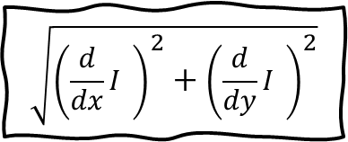
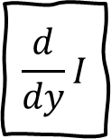
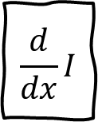
Sobel Edge Detector
$$∗$$
1 | 0 | -1
2 | 0 | -2
1 | 0 | -1
$$\frac{d}{dx}I$$
$$\sqrt{{\left(\frac{d}{dx}I \right)}^{2}+{\left(\frac{d}{dy}I \right)}^{2}}$$
image
threshold
edges
$$∗$$
1 | 2 | 1
0 | 0 | 0
-1 | -2 | -1
$$\frac{d}{dy}I$$
Computer Vision

Slide 53
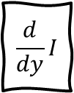

Sobel Edge Detector
$$\frac{d}{dx}I$$
1 | 0 | -1
2 | 0 | -2
1 | 0 | -1
$$\sqrt{{\left(\frac{d}{dx}I \right)}^{2}+{\left(\frac{d}{dy}I \right)}^{2}}$$
threshold
edges
1 | 2 | 1
0 | 0 | 0
-1 | -2 | -1
$$\frac{d}{dy}I$$
Computer Vision

Slide 54




Sobel Edge Detector
$$\frac{d}{dx}I$$
1 | 0 | -1
2 | 0 | -2
1 | 0 | -1
$$\sqrt{{\left(\frac{d}{dx}I \right)}^{2}+{\left(\frac{d}{dy}I \right)}^{2}}$$
$$Δ≥Threshold$$
1 | 2 | 1
0 | 0 | 0
-1 | -2 | -1
$$\frac{d}{dy}I$$
Computer Vision

Slide 55

Basic Comparisons of Edge Operators
Gradient:
Roberts (2x2)
Sobel (3x3)
Sobel (5x5)
$$∇f\left(x,y\right)=\left[\frac{∂f}{∂x},\frac{∂f}{∂y}\right]$$
-1 | 0 | 1
-1 | 0 | 1
-1 | 0 | 1
1 | 1 | 1
0 | 0 | 0
-1 | -1 | -1
-1 | -2 | 0 | 2 | 1
-2 | -3 | 0 | 3 | 2
-3 | -5 | 0 | 5 | 3
-2 | -3 | 0 | 3 | 2
-1 | -2 | 0 | 2 | 1
1 | 2 | 3 | 2 | 1
2 | 3 | 5 | 3 | 2
0 | 0 | 0 | 0 | 0
-2 | -3 | -5 | -3 | -2
1 | -2 | -3 | -2 | 1
0 | 1
-1 | 0
1 | 0
0 | -1
Good Localization
Noise Sensitive
Poor Detection
Poor Localization
Less Noise Sensitive
Good Detection
Computer Vision

Slide 56
Sobel Filter Problems
Poor Localization (Trigger response in multiple adjacent pixels)
Thresholding value favors certain directions over others
Can miss oblique edges more than horizontal or vertical edges
False negatives
Computer Vision

Slide 57
Marr-Hildreth Edge Detector
Computer Vision

Slide 58




David Marr – Ellen Hildreth
Computer Vision

Slide 59




Second Derivative
Image
Profile of a horizontal line
(cross-section)
Laplacian Filter
Maxima-minima of first derivative
Zero-crossings of second derivative
First derivative
Second derivative
Computer Vision

Slide 60

Marr-Hildreth Edge Detector [1980]
Smooth image by Gaussian filter → $S$
Apply Laplacian to $S$
Find zero crossings
Scan along each row, record an edge point at the location of zero crossing.
Apply threshold and mark edges
Repeat above step along each column
Computer Vision

Slide 61






Marr-Hildreth Edge Detector [1980]
$$S=g∗I$$
$$Δ^{2}S=\frac{∂^{2}}{∂x^{2}}S+\frac{∂^{2}}{∂y^{2}}S$$
Laplacian of Gaussian
$$Δ^{2}S=Δ^{2}\left(g∗I\right)$$
$$Δ^{2}S=\left(Δ^{2}g\right)∗I$$
Gaussian
Computer Vision

Slide 62

Marr-Hildreth Edge Detector [1980]
0 | 1 | 1 | 2 | 2 | 2 | 1 | 1 | 0
1 | 2 | 4 | 5 | 5 | 5 | 4 | 2 | 1
1 | 4 | 5 | 3 | 0 | 3 | 5 | 4 | 1
2 | 5 | 3 | -12 | -24 | -12 | 3 | 5 | 2
2 | 5 | 0 | -24 | -40 | -24 | 0 | 5 | 2
2 | 5 | 3 | -12 | -24 | -12 | 3 | 5 | 2
1 | 4 | 5 | 3 | 0 | 3 | 5 | 4 | 1
1 | 2 | 4 | 5 | 5 | 5 | 4 | 2 | 1
0 | 1 | 1 | 2 | 2 | 2 | 1 | 1 | 0
Laplacian of Gaussian
$$Δ^{2}S=\left(Δ^{2}g\right)∗I$$
Computer Vision

Slide 63



Marr-Hildreth Edge Detector [1980]
$$I$$
$$I∗\left(Δ^{2}g\right)$$
Zero crossings of $Δ^{2}S$
Computer Vision

Slide 64



Marr-Hildreth Edge Detector [1980]
Computer Vision

Slide 65



Marr-Hildreth Edge Detector [1980]
$$σ=1$$
$$σ=3$$
$$σ=6$$
Computer Vision

Slide 66
Canny Edge Detector
Computer Vision

Slide 67


Canny Edge Detector [1986]
Smooth image by Gaussian filter → $S$
Compute derivative of filtered image
Find magnitude and orientation of gradient
Apply non-max suppression
Apply thresholding (hysteresis)
John F. Canny
Computer Vision

Slide 68


Canny Edge Detector [1986]
Gaussian
Derivative of Gaussian
$$h_{σ}\left(x,y\right)=\frac{1}{2πσ^{2}}\exp\left(−\frac{x^{2}+y^{2}}{2σ^{2}}\right)$$
$$\frac{∂}{∂x}h_{σ}\left(x,y\right)$$
Computer Vision

Slide 69




Canny Edge Detector [1986]
x-direction
Gaussian
y-direction
Computer Vision

Slide 70
Canny Gradients
Original
X-derivative of gaussian
Y-derivative of gaussian
Gradient Magnitude
Computer Vision

Slide 71
Gradient Orientation
Original
Computer Vision

Slide 72



Non-Max Suppression
Computer Vision

Slide 73


Non-Max Suppression
Computer Vision

Slide 74

Non-Max Suppression
Computer Vision

Slide 75
Non-Max Suppression
Before Non-max Suppression
After Non-max Suppression
Computer Vision

Slide 76
Double Thresholds and Hysteresis
Identifying 3 kinds of pixels:
Strong pixels (or High intensity)
Surely contribute to the final edge
Weak pixels
“Not sure” area. Pixels with intensity not high, but not that low to be considered as non-relevant
Non-relevant pixels (or Low intensity)
Non edge
Computer Vision

Slide 77

Double Thresholds and Hysteresis
Computer Vision

Slide 78

Hysteresis
Wikipedia: The dependence of the state of a system on its history.
Our case: The dependency of a pixel on its neighbors.
a Weak pixel will be categorized as High if it has at least High neighbor among its 8 neighbors.
Computer Vision

Slide 79


Hysteresis
Before Hysteresis Thresholding
After Hysteresis Thresholding
Computer Vision

Slide 80


Final Canny Edges
Computer Vision

Slide 81



Effect of Gaussian Kernel
Original
Canny with $σ=1$
Canny with $σ=2$
Computer Vision
Notes:
The choice of $σ$ depends on desired behavior
•large $σ$ detects large scale edges
•small $σ$ detects fine features

Slide 82





Effect of Gaussian Kernel
Original
Canny with $σ=1$
Canny with $σ=2$
Computer Vision
Notes:
The choice of $σ$ depends on desired behavior
•large $σ$ detects large scale edges
•small $σ$ detects fine features

Slide 83
Computer Vision

Slide 84
45 Years History of Edge Detection
[Pre-Deep Learning]
Computer Vision

Slide 85

45 Years History of Edge Detection
[With Deep Learning]
Computer Vision
Notes:
Liu-Richer

Slide 86

Question?
Computer Vision

Slide 87

Next Agenda
Descriptor
Feature Detection
Computer Vision

Slide 88
References
Yogesh Singh Rawat – CAP5415 Lectures, University of Central Florida
David Fouhey – EECS442 Lectures, University of Michigan
Grauman, K. and Leibe, B. 2011. Visual Object Recognition. Synthesis Lectures Artif. Intell. Mach. Learn. 5, 1 181
Computer Vision

